Slide 1

Department of Computer Science and Engineering CSB4232 – DESIGN PROJECT WITH IOT CONTACTLESS DOORBELL SYSTEM Review-1
Abirajah P A 21113069
Dharshan R E 21113049
Harish Jayaram S S 21113050
SUPERVISORS
Dr.R.Logeshwari, Professor

Slide 2
1.Executive Summary:
An overview of the project:
The Contactless Doorbell System with Local Cloud Server is an creative and practical solution designed to enhance security and convenience in residential and commercial settings. This system utilizes an ESP32-CAM device to detect human presence at the door, capture images, and provide real-time remote monitoring through the Blynk app.

Slide 3
1.Executive Summary:
Key findings:
Enhanced security - Comparing to existing system
User interaction – Best User Interface Software
Privacy and Data Control – More Security
Inspiration for Industry

Slide 4
1.Executive Summary:
Recommendations:
Interface Enhancement – Better template compared to existing system
User Education – Simple and understandable guide to user
Scalability Planning – Make a proper execution planning
Legal and Privacy Compliance – Legal rights to the product and patent
Continuous Improvement – Improvement in app by software update.

Slide 5
Introduction
Background information on IoT and its significance:
IoT, which stands for the Internet of Things, is a term that is used for connecting a bunch of devices we use in the real world to the internet.
The significance of IoT lies in its ability to make our lives more efficient, convenient, and interconnected by enabling devices to communicate, share data for enhancing various industries.

Slide 6
Introduction
Project Objective:
Create a contactless doorbell system
Enable real-time remote monitoring
Capture images
Design an intuitive user interface
Prioritize privacy and data security
Inspire individuals and companies

Slide 7
Introduction
Project Scope:
Designing the hardware setup
Creating the Blynk app interface
Developing the local cloud server
Demonstrating the system's effectiveness through scenarios
Documenting the project's design, development process, and implementation, providing a comprehensive guide for users and developers interested in similar solutions.

Slide 8
Methodology
Description of Research Methods:
The development of the Contactless Doorbell System with Local Cloud Server involves a systematic approach that encompasses diverse research methods to ensure the project's success. These methods contribute to the design, implementation, and validation of the system's functionalities and objectives.
Experimental Testing
User-Centric Approach
Security Assessment
Iterative Development - Continuous adjustments

Slide 9
Methodology
Techniques used:
Hardware Integration – Integrating Hardware components in board
Software Development – Creating template in software
Practical Experimentation – Human presence test
Security Assessment – Testing vulnerabilities
User Testing – Engaging user interact with interface
Iterative Refinement – Continuous refinement of hardware and software
Ethical Considerations – Obtain user consent

Slide 10
Methodology
Data collection procedures:
1.Human Presence Detection
2.Image Capture and Storage
3.Blynk App Usage
4.Security and Privacy

Slide 11
Literature review/Existing Systems
S.No | Title of the paper/System | Authors | Publication (Name of the Journal/Conference proceedings with Year) | Algorithm/Methodology adopted | Limitations
1. | Contactless IoT Doorbell | Ms.Shefali Raina, Vishwesh Pratap Singh, Md.Sajid Akhtar, Sidhant Ranjan Rishabh& Ajab Singh | 22nd Journal of Emerging Technologies and Innovative Research(JETIR), 2022 | Ultrasonic sensor detects infrared changes Using of Arduino UNO to send info to mobile | Costlier than esp32 Latency of information
2. | Doorbell System in Home Using IoT | B.Baron Sam1 , K. Purna Chander , K. Vinay & , A.Pio sajin | International Conference on Frontiers in Materials and Smart System Technologies,2021 | Utilizes protocols like MQTT or HTTP for efficient communication. Fine-tune sensor parameters to reduce negatives and optimize | High Power Consumption Old Usage of sensor

Slide 12
Literature review/Existing Systems
S.No | Title of the paper/System | Authors | Publication (Name of the Journal/Conference proceedings with Year) | Algorithm/Methodology adopted | Limitations
3. | IoT & AI Based Smart Doorbell System | Prof. S.B. Sahu, Arati F. Paswan &, Kavita K. Tandi | International Journal Of Creative Research Thoughts,2021 | Employs deep learning models (e.g., CNN) to analyze captured images. Set up cloud services (e.g., AWS, Azure) for data storage and processing. | Lack of combability. Security Risks
4. | A STUDY ON IOT SMART DOORBELLS | C.K Gomathy, & Devulapalli | International Journal Of Creative Research Thoughts,2021 | Classifies visitors, distinguishes between humans, animals, and objects. Validate AI model accuracy, system responsiveness, and image analysis effectiveness. | Bias in AI Models: AI models may inherit biases from training data, affecting visitor classification accuracy.

Slide 13
Literature review/Existing Systems
S.No | Title of the paper/System | Authors | Publication (Name of the Journal/Conference proceedings with Year) | Algorithm/Methodology adopted | Limitations
5. | IoT & AI Based Smart Doorbell System | Prof. S.B. Sahu, Arati F. Paswan &, Kavita K. Tandi | International Journal Of Creative Research Thoughts,2021 | Employs deep learning models (e.g., CNN) to analyze captured images. Set up cloud services (e.g., AWS, Azure) for data storage and processing. | Lack of combability. Security Risks
6. | A STUDY ON IOT SMART DOORBELLS | C.K Gomathy, & Devulapalli | International Journal Of Creative Research Thoughts,2021 | Classifies visitors, distinguishes between humans, animals, and objects. Validate AI model accuracy, system responsiveness, and image analysis effectiveness. | Bias in AI Models: AI models may inherit biases from training data, affecting visitor classification accuracy.

Slide 14
Literature review/Existing Systems
S.No | Title of the paper/System | Authors | Publication (Name of the Journal/Conference proceedings with Year) | Algorithm/Methodology adopted | Limitations
7. | IoT & AI Based Smart Doorbell System | Prof. S.B. Sahu, Arati F. Paswan &, Kavita K. Tandi | International Journal Of Creative Research Thoughts,2021 | Employs deep learning models (e.g., CNN) to analyze captured images. Set up cloud services (e.g., AWS, Azure) for data storage and processing. | Lack of combability. Security Risks
8. | A STUDY ON IOT SMART DOORBELLS | C.K Gomathy, & Devulapalli | International Journal Of Creative Research Thoughts,2021 | Classifies visitors, distinguishes between humans, animals, and objects. Validate AI model accuracy, system responsiveness, and image analysis effectiveness. | Bias in AI Models: AI models may inherit biases from training data, affecting visitor classification accuracy.

Slide 15
Literature review/Existing Systems
S.No | Title of the paper/System | Authors | Publication (Name of the Journal/Conference proceedings with Year) | Algorithm/Methodology adopted | Limitations
9. | IoT & AI Based Smart Doorbell System | Prof. S.B. Sahu, Arati F. Paswan &, Kavita K. Tandi | International Journal Of Creative Research Thoughts,2021 | Employs deep learning models (e.g., CNN) to analyze captured images. Set up cloud services (e.g., AWS, Azure) for data storage and processing. | Lack of combability. Security Risks
10. | A STUDY ON IOT SMART DOORBELLS | C.K Gomathy, & Devulapalli | International Journal Of Creative Research Thoughts,2021 | Classifies visitors, distinguishes between humans, animals, and objects. Validate AI model accuracy, system responsiveness, and image analysis effectiveness. | Bias in AI Models: AI models may inherit biases from training data, affecting visitor classification accuracy.

Slide 16
Literature Review
Research on IoT and related technologies:
The research landscape in IoT and related technologies is diverse and impactful, addressing various aspects of implementation and challenges:
Implementation Focus
Security and Privacy
Edge and Fog Computing
Interoperability and Standards
Sustainability

Slide 17
Literature Review
Key Concepts:
Human Presence Detection
Real-Time Communication
Remote Interaction
Trends:
Enhanced User Experience
Edge Processing
Security Focus
Challenges on IoT implementation:
Accurate Detection
User Privacy
Data Security
Compatibility
Power Management
Network Reliability
Environmental Factors

Slide 18
Design Requirements:
Identification and explanation of the specific requirements for the IoT design project:
1.Accurate Human Presence Detection:
2.Real-Time Alerts and Image Capture:
3.Secure Data Transmission
4.Intuitive User Interface
5.Local Cloud Server Setup
6.Energy Efficiency
7.Remote Door Unlock Functionality
8.User Privacy

Slide 19
Design Requirements:
Considerations for hardware, software, connectivity, security, and user experience:
1.Hardware:
Sensor Selection
Camera Quality
2.Software:
App Interface
Local Cloud Server Software
Compatibility
User Authentication

Slide 20
Design Requirements:
3.Connectivity:
Network Options
Stable Connection
4.Security:
Encryption
User Data Protection
5.User Experience:
Ease of Use
Speed and Responsiveness

Slide 21
System Architecture
Overview of the proposed system architecture for the IoT design:
The proposed system architecture for the IoT-based contactless doorbell system presents a comprehensive framework that integrates hardware, software, and connectivity components to create an efficient and user-friendly solution. This architecture is designed to provide accurate human presence detection, real-time communication, secure data handling, and seamless user interaction.

Slide 22
System Architecture:
Components and Interconnections:
1.Human Presence Detection Sensor:
2.Microcontroller
3.Camera Module
4.Local Cloud Server (Hosted on Windows Platform)
5.Smartphone App (iOS/Android)

Slide 23
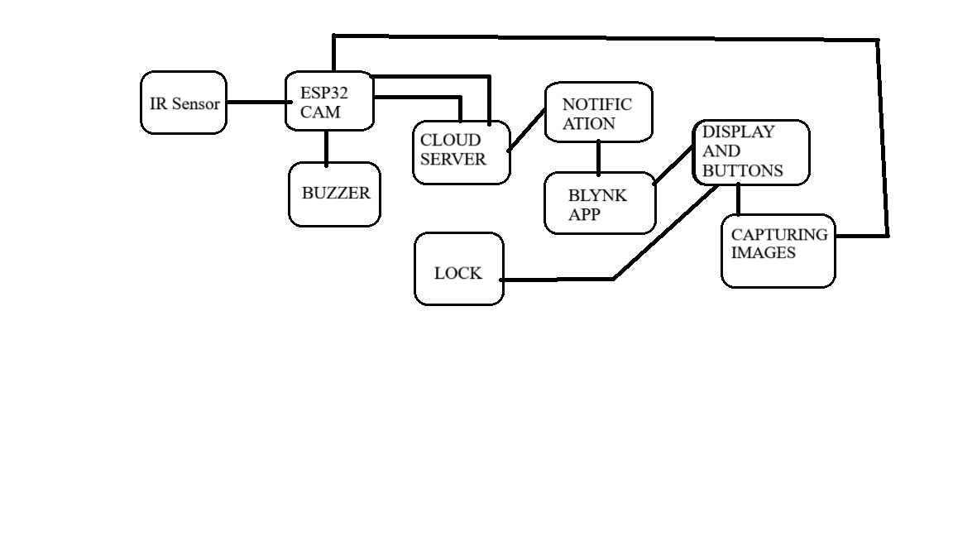
System Architecture: Data Flow

Slide 24
Hardware Design:
Detailed explanation of the hardware components and their specifications.
1.LED and Resistor (1 ohm)
2.Battery 12v or 9v
3.Breadboard
4.Buzzer
5.Solenoid Lock
6.Push Button
7.Relay Module
8.UART TTL Module

Slide 25
Hardware Design:
Detailed explanation of the hardware components and their specifications.
9.7805 IC Voltage Regulator
10.25V 100uF Capacitor
11.IR Proximity Sensor
12.ESP32-CAM

Slide 26
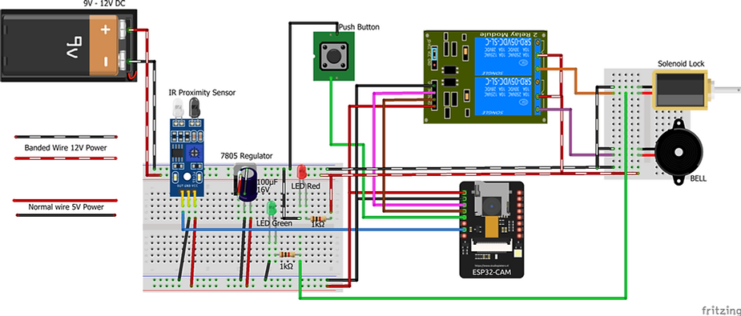
Hardware Design:
Circuit diagrams, schematics, and PCB layouts if applicable.

Slide 27
Hardware Design:
Sensor Selection – Choosing of IR proximity sensor
Actuator Integration – Integrating microcontroller to control devices
Power Management – Optimizing the battery performance and efficiency

Slide 28
THANK YOU

